Slide 1



Crowdsourcing Metadata
Reliably Augmenting Documents By Collecting and Interpreting Amateur Contributions
Peter Organisciak
September 22, 2015
1
Notes:
Good morning.
Thank you for coming.
Particularly, I’d like to thanks my committee: Mike, Miles, Jaime, and Stephen for their time.

Slide 2
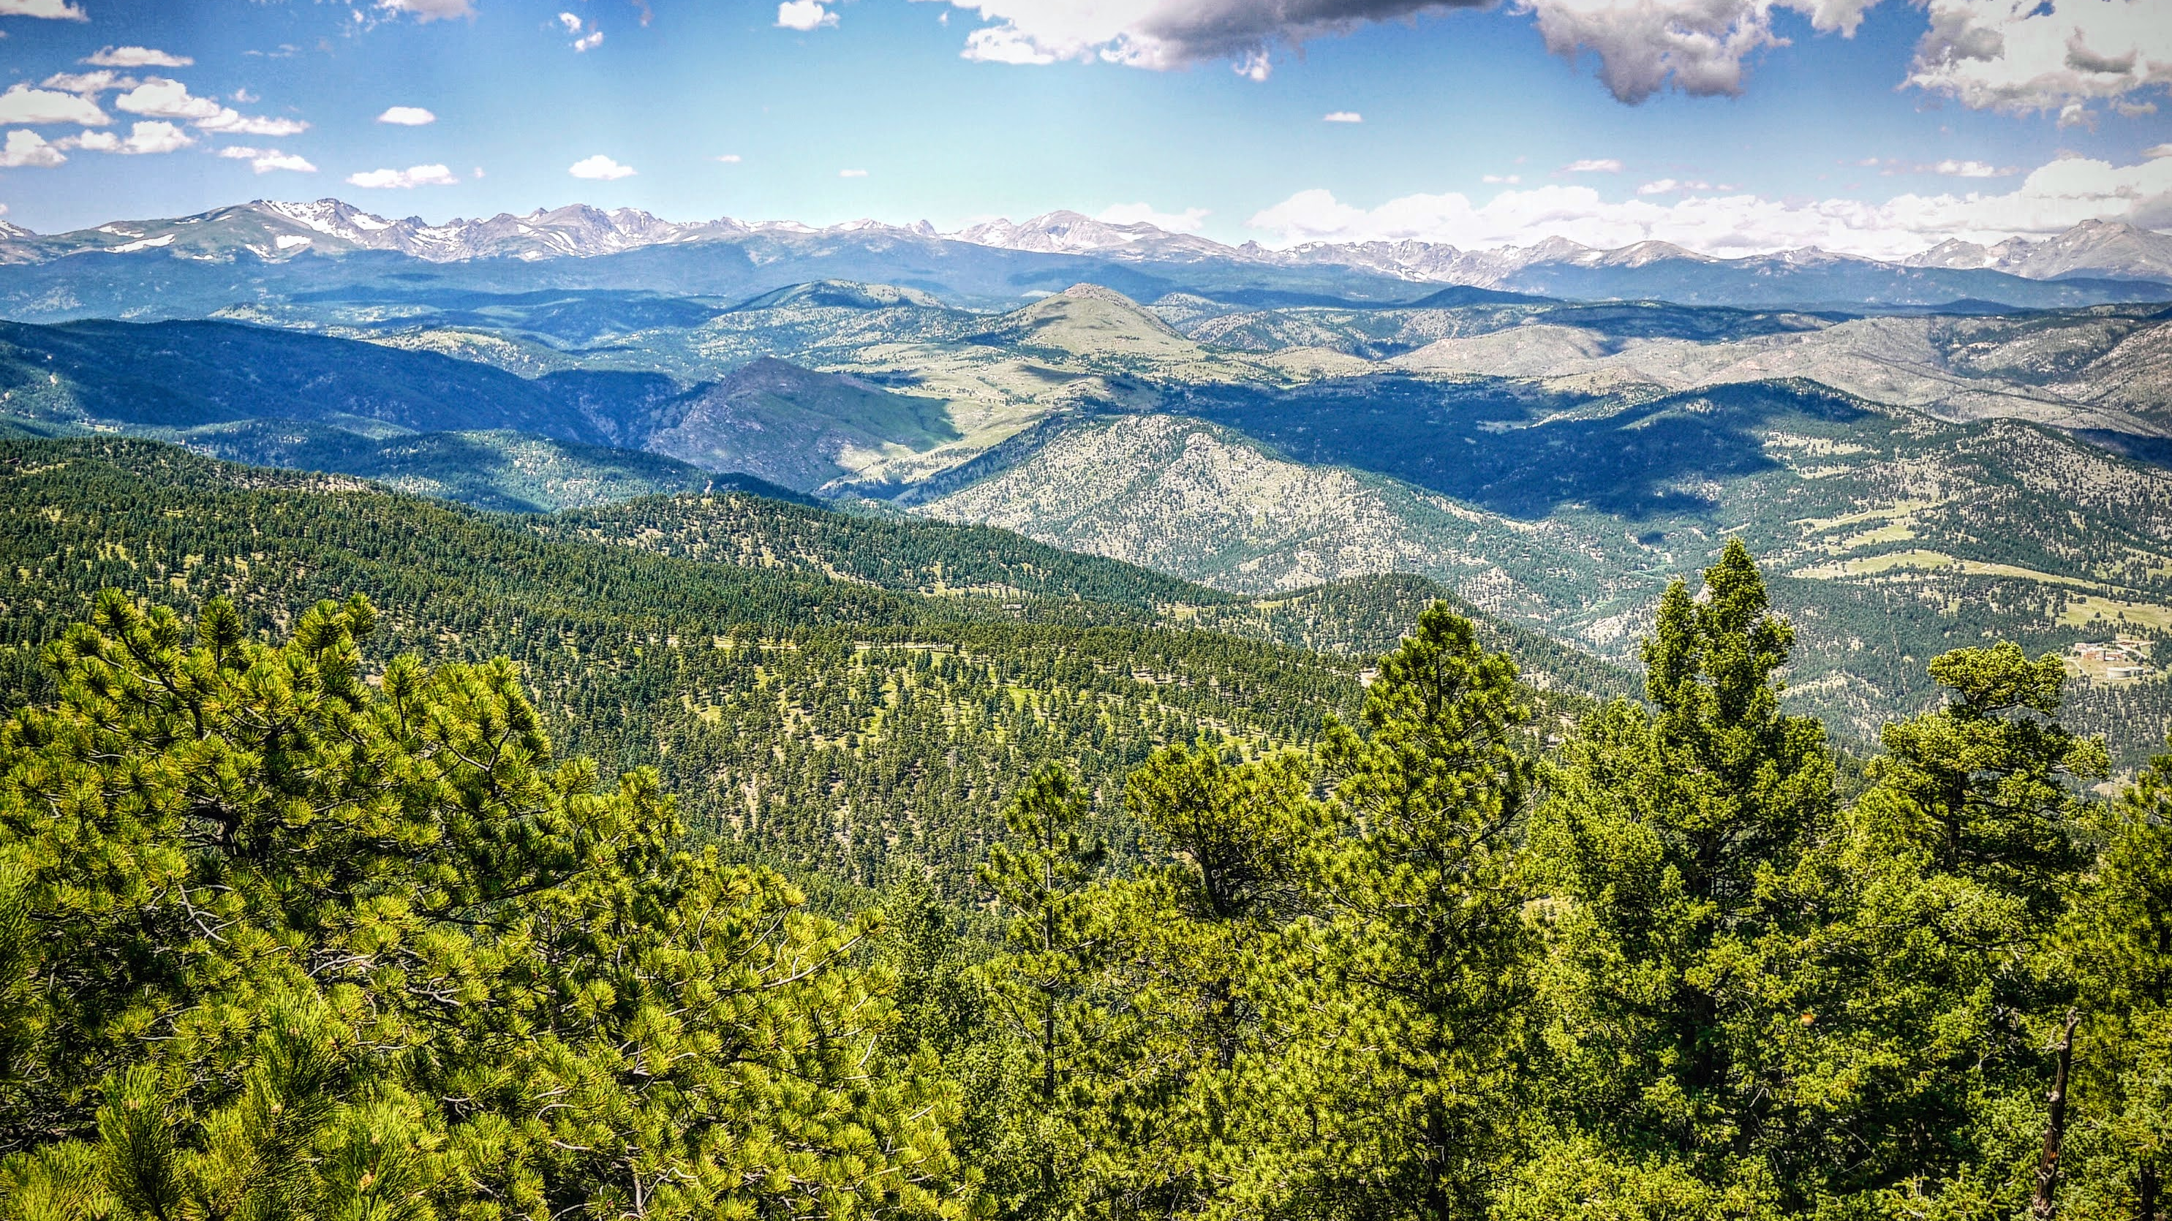

Maximizing data quality
in using paid crowds for objective and
subjective encoding tasks
Notes:
So, let’s return to that problem statement.

Slide 3
INTRODUCTION
Crowdsourcing



Commons-Based Peer Production

Human Computation
Free/Open Source
Human work organized in the manner and tropes of computation
Creation from the commons, stemming from increased agency in networked information economy.
Crowdsourcing
A principle of software source code openness that evolved into a model of hyper-collaboration, often without discrimination toward the contributor, and quick user-focused development.
Broadly describes the use of distributed crowds to complete a task that would otherwise be done by one or a few people.
Captures the ability of the Internet toefficiently connect people


User Innovation
Wisdom of the Crowds
Shifting focus on creation by a product’s users.
observes the collected effectiveness of crowds when properly aggregated
von Hippel 1988
Raymond 1999
von Ahn 2004
Surowiecki 2004
Benkler 2006
Howe 2006
3
Notes:
Crowdsourcing refers to the action of outsourcing a task that might traditionally be done by a single person to a large, often self-selected group of people.
It was coined in an article of Wired in 2006. However, the idea of many amateurs collaborating directly or indirectly on the same product is not new, and different facets of crowdsourcing were previously studied.
<slide>
In 2006, Yokai Benkler wrote Wealth of Networks, a critical work trying to understand networked information society. There, he noted the ability of the Internet to empower people to create information goods for each other in the commons, rather than receiving them from firms.
Eric von Hippel has been making a similar argument for decades, around technology’s recontextualization on users.
In 2004, pop science book Wisdom of the Crowds popularized interest in the collective intelligences of crowds, when they are well connected.
That same year, the concept of Human Computation was beginning to gain traction. If the wisdom of the crowds refers to the unique abilities of human intelligence in aggregate, human computation focuses on human abilities as distinct from computational methods -- for so long as they are distinct -- and aims to formalize methods to organize humans in manners akin to automation.
Of course, the vanguard of how well people can collaborate through the aid of networked technology is the free software movement, with started by sharing source code for software but experienced a sea change with the hyper-collaborative Linux project in the early 90s.

Slide 4
INTRODUCTION
Information Science
Image Tagging
Content Recommendation
Describing images in different language.
e.g. steve.museum, The Commons
Judging information quality, reviewing/filtering, user-curated lists.
e.g. Bibliocommons


Relevance Judgments (IR Evaluation)

Generate custom evaluation datasets over novel corpora.


−
Transcription
e.g. Transcribe Bentham, Trove, What’s on the Menu
Research
Other Encoding
Galaxy Zoo, Snapshot Serengeti
4

Slide 5
INTRODUCTION
Types of Crowdsourcing
Paid
Creative
Volunteer
Reactive
Reactions to existing information objects
Subjective
A ‘good’ contribution depends on context
Objective
Working toward a universal or agreeable ‘truth’
5
 More in chapter: Design Facets of Crowdsourcing: A Typology for Information Science

Slide 6
Online crowds are useful because they’re quick, accessible at large-scales, but also
Perceptive
Clever
Critical
Notes:
This is a boon for certain types of research, but also introduces issues due the subjectivity inherent to certain

Slide 7
Why does this matter?
Digitized and born-digital information is outpacing our ability to clean, annotate, organize it. Crowdsourcing is being used to address these problems
In information retrieval,
Custom evaluation datasets (research over novel datasets!) – e.g. Alonso 2008
Understanding unseen queries (e.g. Chen and Jain 2013)
Adding additional metadata to documents implicitly (e.g. Lamere 2008) or on-demand (e.g. Finin et al 2010)

Slide 8
Why does this matter?
Crowdsourcing is the path toward qualitative big data
Notes:
As a digital humanist I’m well aware of the discord between qualitative close reading and large-scale quantified research. These activities that people are so good at -- description, judgment, criticism, interpretation – these often fall by the wayside as we work with bigger datasets, bigger collections. Crowdsourcing helps us bring it back.

Slide 9
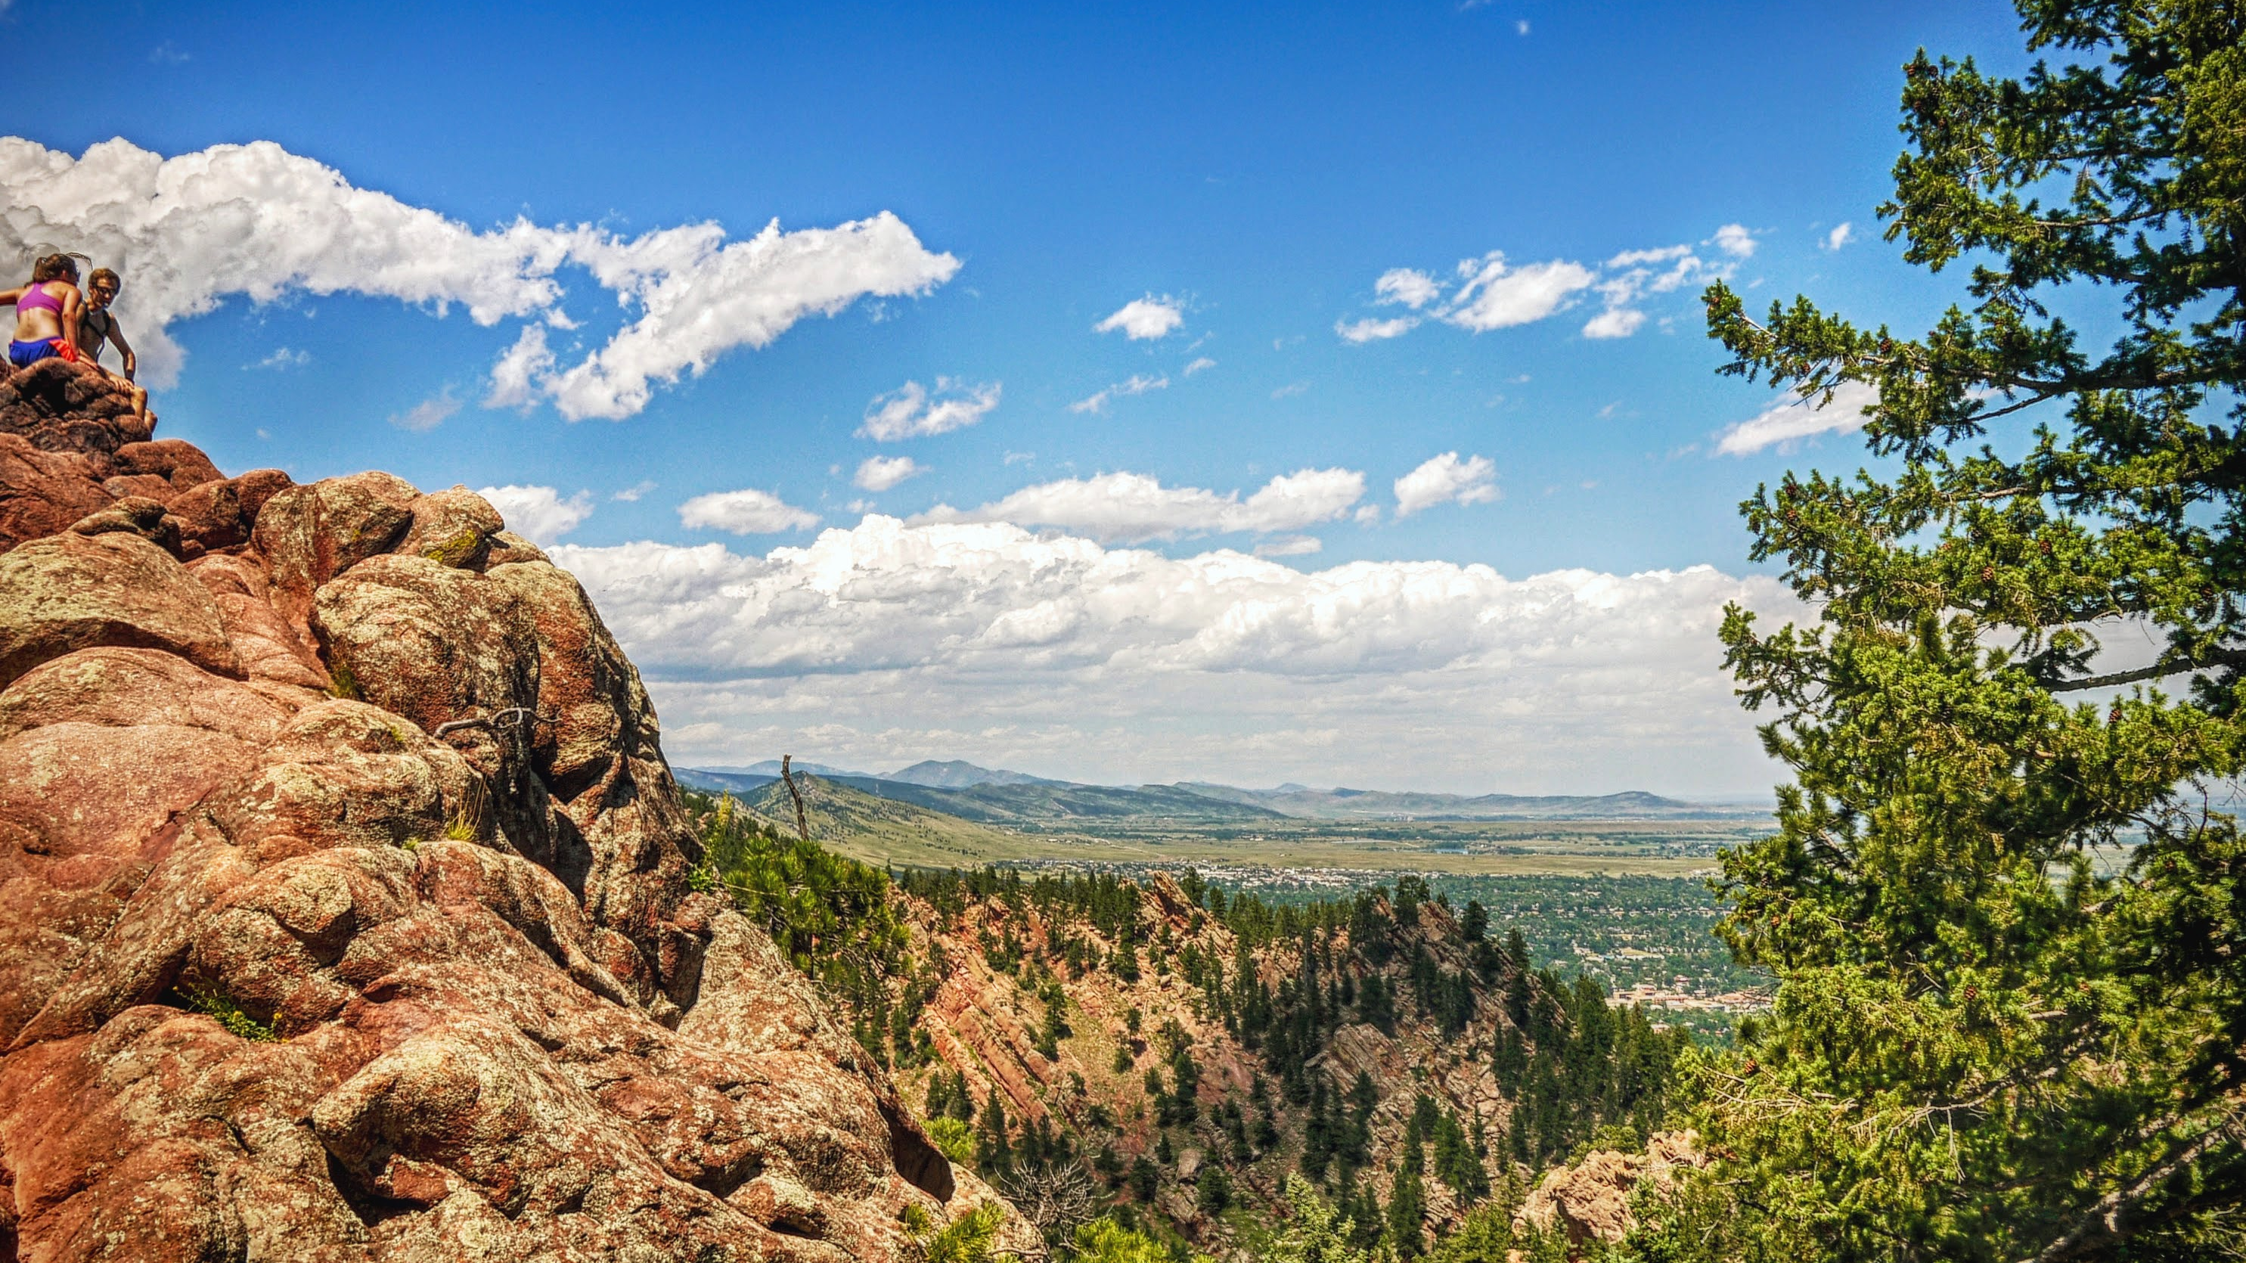
❑
However, humans have predictable and unpredictable biases that make it difficult to systematically adopt their contributions in an information system.
Notes:
Today, I’m presenting my dissertation research pertaining to data quality issues in crowdsourcing.
How do you interpret and collect contributions from paid online crowds reliably?
Before I delve too deep into what exactly that means, it’s important to understand some of the background around what is known as crowdsourcing and how it pertains to us.

Slide 11

Maximizing data quality
in using paid crowds for objective and
subjective encoding tasks
Notes:
So, let’s return to that problem statement.

Slide 13
INTRODUCTION
Typical Task



13

Slide 14
INTRODUCTION
This study’s focus









14

Slide 15
INTRODUCTION
Research Questions
Broad Research Question #1
Broad Research Question #2
Broad Research Question #3



What are the post-collection indicators of quality in worker-contributed objective task data, and can these be leveraged for improved data modelling?
What are the biases inherent to the task design for objective or normative tasks (i.e. the data collection instrument), and can design manipulations correct for them at collection time?
What are the quality losses when treating non-normative tasks in objective ways, and can collection-time framing or post-collection modeling approaches reduce these?
15

Slide 16
INTRODUCTION
Scope
Paid
Creative
Volunteer
Reactive
Reactions to existing information objects
Subjective
A ‘good’ contribution depends on context
Objective
Working toward a universal or agreeable ‘truth’
16

Slide 17
Broad Research Question #1
Broad Research Question #2
Broad Research Question #3



What are the post-collection indicators of quality in worker-contributed objective task data, and can these be leveraged for improved data modelling?
What are the biases inherent to the task design for objective or normative tasks (i.e. the data collection instrument), and can design manipulations correct for them at collection time?
What are the quality losses when treating non-normative tasks in objective ways, and can collection-time framing or post-collection modeling approaches reduce these?
17

Slide 21
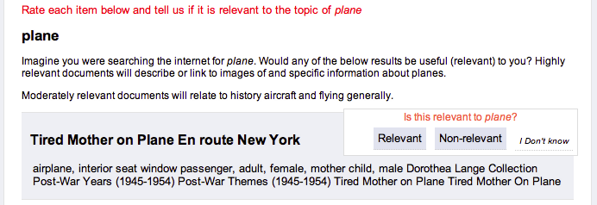
People like to interpret
Better contributions come from people that spend more time reading instructions
Notes:
One of the tenants of classification research in library science is the importance of codebooks for achieving inter-coder reliability. However, online people are used to short, succinct interactions, and they often don’t read the instruction set.
Alt Hypothesis: Spending more time on a tasks indicates better performance (Wilcoxon Rank Sum p < 0.001, with Bonferroni adjustment),

Slide 22
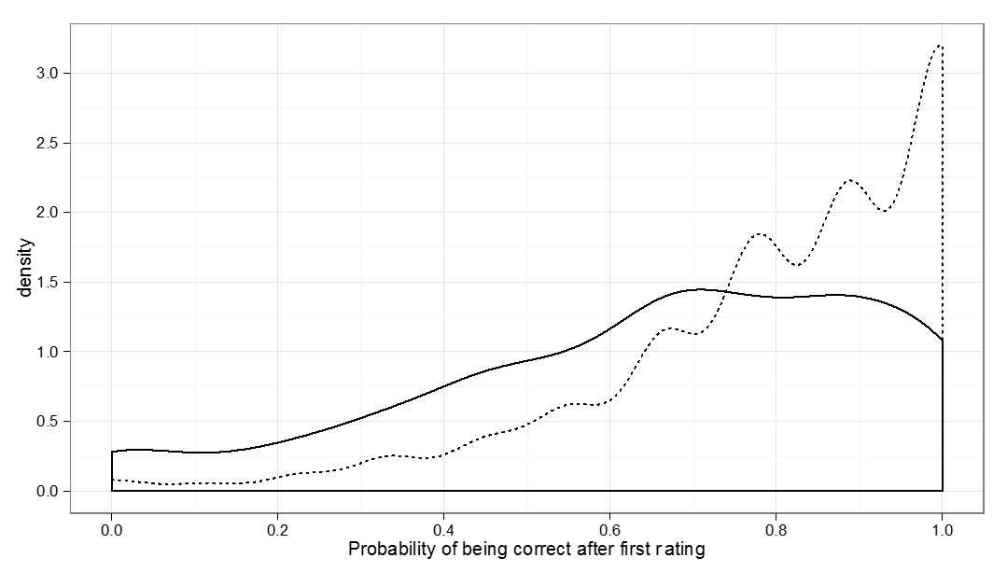
Notes:
One of the tenants of classification research in library science is the importance of codebooks for achieving inter-coder reliability. However, online people are used to short, succinct interactions, and they often don’t read the instruction set.

Slide 23
How do you control for different interpretations of a task?
Scaling up difficulty
Normalizing for user-specific biases
Training, testing
Feedback
Anchoring

Slide 26
Broad Research Question #1
Broad Research Question #2
Broad Research Question #3



What are the post-collection indicators of quality in worker-contributed objective task data, and can these be leveraged for improved data modelling?
What are the biases inherent to the task design for objective or normative tasks (i.e. the data collection instrument), and can design manipulations correct for them at collection time?
What are the quality losses when treating non-normative tasks in objective ways, and can collection-time framing or post-collection modeling approaches reduce these?
26

Slide 41
Broad Research Question #1
Broad Research Question #2
Broad Research Question #3



What are the post-collection indicators of quality in worker-contributed objective task data, and can these be leveraged for improved data modelling?
What are the biases inherent to the task design for objective or normative tasks (i.e. the data collection instrument), and can design manipulations correct for them at collection time?
What are the quality losses when treating non-normative tasks in objective ways, and can collection-time framing or post-collection modeling approaches reduce these?
41

Slide 43
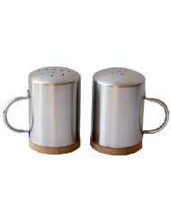
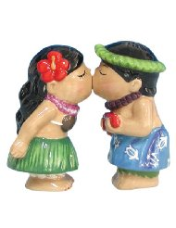
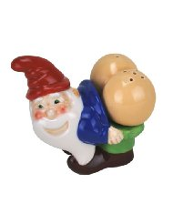
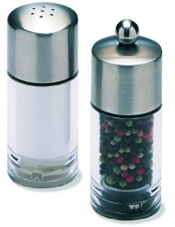
Notes:
I have a question.
Say you’re looking for a new set of salt and pepper shakers for your home Do you….
<click>… go for the charming kitsch of the kissing figures?
<click>Choose sleek option B?
<click>Perhaps you prefer the gift shop novelty of C or <click>the hominess of D?
(Ask audience for opinion)

Slide 44
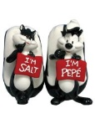

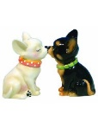

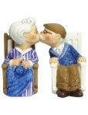
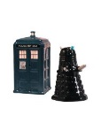
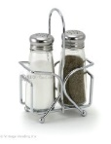
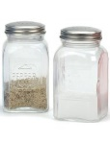
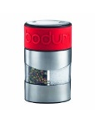
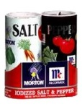
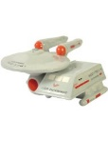
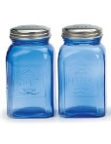

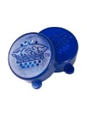
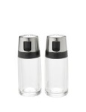

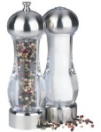
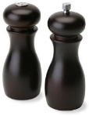
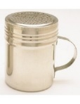
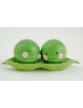
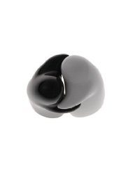
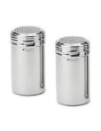
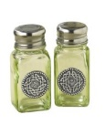
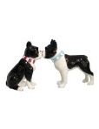
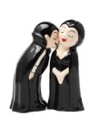
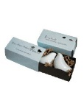
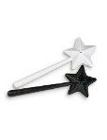
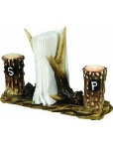
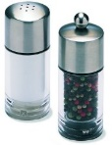

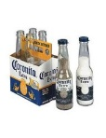
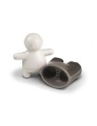
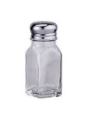
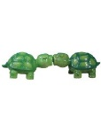
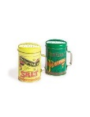
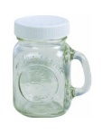
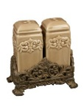
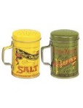
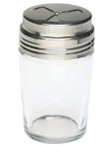
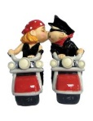

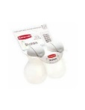
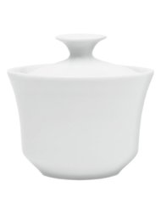
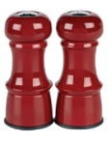
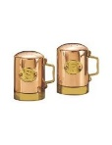
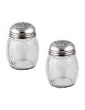
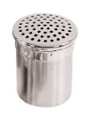
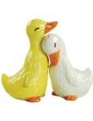










































Notes:
Okay, realistically we know that the space of salt and pepper shakers is much large than four.
that perfect item may be out there, but it doesn’t seem like something worth sinking too much of your time into.
Today we tackle this problem, of things you may not want to do, but that depend on your opinion that you have.
We do so, of course, through crowdsourcing.

Slide 45
















































































Notes:
In a case like this salt shaker example, you can use crowds to reduce your space considerably.
If you like the kissing Hawaiian, there’s many more similarly cute product (including a whole subgenre of kissing dogs)
If you like the gnome, there only two others for you, neither of which should be would be appropriate in this forum…

Slide 46













Notes:
How about other cases, like finding the food you’re craving ….

Slide 47

Notes:
Or filtering out the best photos from your vacation?

Slide 48
Good for…
Personal collections
New corpora
Niche information
Time-dependent preferences
Notes:
Why would you want on-demand personalization?
Good for collections with little existing data
Personal collections
E.g. personal photos, email
New corpora of data
E.g. the next Amazon, Netflix
Niche information
Where nobody would care enough to collect such preference data, nor would people care to volunteer it
Time-dependent opinions
When things change (e.g. food cravings, film desires), it’s difficult to collect information over an extended period of time

Slide 49
Research Question
How can crowdsourcing be applied to subjective data?
Approach
Introduce two approaches to personalized crowdsourcing – taste-matching and taste-grokking
Evaluate them against multiple tasks and task types
Scope
Paid crowdsourcing via Mechanical Turk
Notes:
Goal
To evaluate the feasibility of personalization through crowdsourcing
Also measure the crowd effort and return relationship
Focus on paid crowds, not as a rule, but because the question of motivation is tricky and confounding: we want to know if it works, then we can work on how to motivate users

Slide 50
†
‡
We show that crowdsourcing is useful for personalization
† Spoiler alert
‡ with nuances – this is where we help!
Notes:
…
3. We show that crowdsourcing can be useful for personalization.
First of all:
<click>
Sorry for giving away the ending, but also, the fun lies….
<click>
… in the nuances.
We evaluate numerous contexts over various data
Giving us an impressive of what is appropriate, when

Slide 51
Taste-matching
Requester
$$sim(requester, worker)$$
Crowd Worker
Notes:
How do our approaches work? In the first…
Taste-matching
Things to note
Finding your taste-soul mate; building your turker army
Similar to on-demand collaborative filtering
You can borrow techniques from there, e.g. sim measures
Where it can change
Similarity metric
Choice of training items
Size of training set
Not worth mentioning in talk: (Recommendation method: do you take a single similar worker’s suggestion, or an aggregate)

Slide 52
Taste-Grokking
Requester
Requester
Crowd Worker
Notes:
Taste-Grokking
Things to note:
No similarity measure
Showing by doing
Similar approach, but communicating by explanation, is utilized for travel-planning with Mobi (Zhang et al.) and

Slide 53




Requester
Requester
Requester
Requester
Notes:
Since multiple grokkers are thinking of the same person, grokking lends itself easily to aggregation

Slide 54

Notes:
Like the proverbial blind men beholding an elephant, each grokker has their own interpretation of the truth that is more effective in the bigger picture.
(No known copyright, http://www.loc.gov/pictures/item/2004666374/)

Slide 55














Task 1: Image Recommendation
Products
?
?
?
?
Food
?
?
?
?
Notes:
We applied these two protocols, taste-matching and taste-grokking, to two different types of tasks
Size of set used for profiling: 10 items; size of recommendation set:90
Image Recommendation
Product recommendation
Specifically, saltshakers
A highly visual decision, not common to find people rating multiple saltshakers in existing data
Food
Photo and name given
Two datasets provided, via Foodspotting: Seattle and Boston.
Quality of photo controlled for, somewhat, by sampling only most popular photos.
These are photos of food that are already liked, we want to differentiate by people

Slide 56
Results
Taste-Matching
Measured using root-mean-squared-error, to measure deviation of recommendation from ground truth of requester preferences
 | Products | Food Set #1 | Food Set #2
Baseline | 1.64 | 1.51 | 1.58
Best matched of five-workers | 1.43 (13%) | 1.19 (22%) | 1.26 (20%)
Best matched of ten workers | 1.35 (18%) | 1.08 (29%) | 1.08 (31%)
Notes:
The quality of the workers you find depends on how man you ask.
If you take the word of 1 person (the baseline)…
If you match against five people and use the opinion of the best…
Match against 10 people…
I’ll discuss this further later, but note that
Improvements on both sides, but
<click>
Food data was better improved by matching than product data
(why not aggregate taste-matching? This is possible; we were thinking of cases where you can accumulate ‘assistants’ that would look at different parts of the dataset for you)

Slide 57
Results
Taste-Grokking
 | Products | Food Set #1 | Food Set #2
Baseline | 1.64 | 1.51 | 1.58
Any grokker | 1.29 (21%) | 1.53 (1.3%) | 1.57 (0.5%)
5 rand grokkers | 1.07 (34%) | 1.38(9%) | 1.28 (19%)
5 good grokkers | 1.02 (34%) | 1.22 (19%) | 1.13 (28%)
Notes:
We found the inverse to be true for taste-grokking.
For taste-grokking, the salt-shakers are predicted much better.
For the food, if you ask anybody to guess, they’re not going to be that good; asking a few peope improves that recommendation.

Slide 58


Results
Personalization in this form was a good fit for crowdsourcing
Matching was better for food, grokking better for salt-shakers
Latent vs. Manifest decision factors: overfitting mental models
Increases in N are more fruitful for matching
Notes:
Matching was better for food, grokking better for salt-shakers
Why?
The factors of saltshaker decision making is more visible
When we tried clustering by taste, we saw more surprised in how food groups: overfitting mental models
In a complex space like food, you may need more profiling examples
If you can afford it, added people to matching keeps improving quality
In grokking, you only need a few people

Slide 59
Super-grokkers
The best grokkers outperform the best-matched
 | Products | Food | Food
Baseline | 1.64 | 1.51 | 1.58
Taste-matching: Best 3 workers | 0.89 (46%) | 1.02 (32%) | 1.19 (25%)
Taste-grokking: Best 3 workers | 0.87 (47%) | 0.78 (48%) | 0.79 (50%)
Notes:
- The trick is identifying them beforehand, which is difficult to do

Slide 60
























Requester
Requester
Crowd Worker
Notes:
In all these experiments, we randomized the training examples, but it should be noted that the training data matters.
When we purposively chose profiling information to maximize breadth…

Slide 61

Notes:
We saw a clear improvement in grokking ability.

Slide 62

Task 2: Text Summarization
Film Reviews
Notes:
Recommendation is a fairly straightforward task. Can we personalize on much more complex tasks?
To this end, we looked at the ability of crowd workers to highlight film reviews for summarization. They would try to mimic both the salient content, and the amount of highlighted.
- difficult to measure, we used text overlap via F1 measure (the harmonic mean btw precision and recall)
Training example N=1 (based on expected information communicated)

Slide 63
Matching does work for a complex task like this
Grokkers fare poorly, but once again, we see super-grokkers
Potentially an appropriate task for written expression of needs, a la EmailValet (Kokkalis et al. 2013) and Mobi (Zhang et al 2012)
 |  | Performance ($F_{1}$)
Baseline |  | 0.32
Taste-matching | Best-matched workers | 0.39 (20%)
 | 5 best-matched workers | 0.38 (17%)
Taste-grokking | Any worker | 0.30 (7%)
 | Best workers (pool of 5) | 0.52 (62%)
Notes:
Film highlighting
Surprisingly, matching does work for a complex task like this

Slide 64
Matching or Grokking
Data Re-use
Grokking is requester-specific; matching is useful for bootstrapping collaborative filtering and has higher ceiling.
Quality Control
Grokking is task-driven, with apparent ground truth – traditional quality control can be used.
Task Complexity
Are the factors affecting opinion-forming easy to communicate by example?
Satisfaction
Feedback suggests grokking seems more fun
Notes:
Grokking is task-driven, with apparent ground truth – traditional quality control can be used.
In matching, workers are asked to give their opinion, so it’s hard to tell if they are cheating; however, they’ll usually remain unmatched
Task complexity
Are the factors affecting opinion-forming easy to make sense of?
- Our workers spoke of their decision making for salt-shakers in predominantly visual terms

Slide 65
Takeaway
Crowdsourcing doesn’t have to be only objective or normative tasks! It is promising in domains where lack of prior data limits established personalization methods.
Taste-matching is good for personalizing complex tasks, and ongoing engagements with workers
Taste-grokking is great for quick-start tasks with manifest opinion factors, and for spicing up boring tasks

